Slide 1
드론 트레이닝 시스템
이착륙장

Slide 2
Revision
Version | Date | Remark
2.0 | 17/11/09 | 초안 작성
2.1 | 17/11/21 | 데이터 포맷 변경

Slide 3
목차
개발 개요
요구 사항
장치 사양
개발 구성
사용 구성도
시스템 구성도
데이터 포맷 & 스위치 배치 & LED제어
프로토콜
개발 현황
17/07/13
17/09/12
17/09/26
문제점

Slide 4
개발 개요 – 요구 사항
이착륙장에 배치한 스위치를 통해 어느 위치에 드론이 착륙했는지 확인해야 함.
LED로 이착륙장의 상태 표현 및 착륙 유도를 해야함.
그라운드 시스템과는 ZIGBEE통신을 사용.
2.0 추가사항
드론의 무게와 풍압에 영향을 받지 말아야 함.
유지보수가 용이해야 함.

Slide 5
개발 개요 – 장치 사양
크기 : 80 x 80 x 20 (단위:cm)
무게 : ?
초음파 센서와 지면 간 각도 : 20º
A안
초음파 센서 간 간격 : 13.3cm
B안
초음파 센서 간 간격 : 20cm

Slide 6
개발 개요 – 개발 방향
A안
초음파 센서 6개를 일렬로 배열
거리측정으로 위치파악
B안*
초음파 센서 X축 3개, Y축 3개 배열
교차 감지되는 공간으로 위치파악

Slide 7



개발 구성 – 사용 구성도
이착륙장
그라운드 시스템

Slide 8
개발 구성 – 시스템 구성도
출력 처리부
LED 릴레이모듈 제어
LED
센서 데이터 수집부
시리얼 모니터 출력
컴퓨터
센서 데이터 처리 및 저장
이착륙장
센서 데이터 변화 감지
통신 데이터 처리부
데이터 패킹 및 송신
그라운드 시스템
Ack수신 시 송신 중단
ZIGBEE
ACK메세지 수신 및 파싱

Slide 9
개발 구성 – 데이터 포맷 & 초음파센서 배치 & LED제어
Bytes | Bits
 | B0 | B1 | B2 | B3 | B4 | B5 | B6 | B7
0 | 사용하지 않음(0) |  |  |  |  |  |  | 9
1 | 8 | 7 | 6 | 5 | 4 | 3 | 2 | 1
Type : uint16_t(2바이트)
Name : pos_state
해당 초음파가 감지한 거리에 따라 해당 비트를 1로 체크, 그 외 0
물체가 이착륙장에 존재하지 않을 시, LED출력은 파란색
5번 위치 외의 다른 위치에 물체 존재 시, LED출력은 빨간색
5번 위치에 물체 존재 시, LED출력은 초록색
H
9
8
7
3
6
5
4
2
3
2
1
1
4
5
6

Slide 10
개발 구성 – 프로토콜
Bytes | Bits
 | B0 | B1 | B2 | B3 | B4 | B5 | B6 | B7
0 | 장비 식별용 비트 |  | 고유 번호
1 | 드론 위치 데이터
2
3 | 데이터 송신 종료 바이트 (0x0D)
패킷 크기 : 4byte(이착륙장에만 한해서)
장비고유번호
장비 식별용 비트
이착륙장 0b01
게이트 0b10
그라운드 시스템 0b11
고유번호 : 1 ~ 63
ACK메세지는 장비고유번호만 그라운드 시스템으로 바꾸어 받은 데이터를 그대로 전송 받음

Slide 11
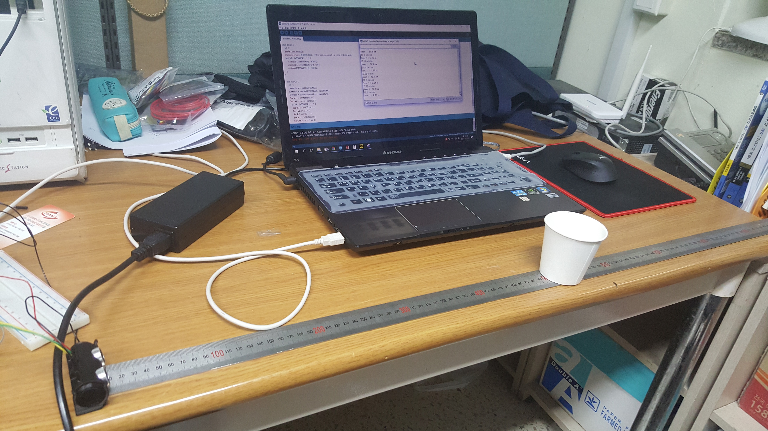
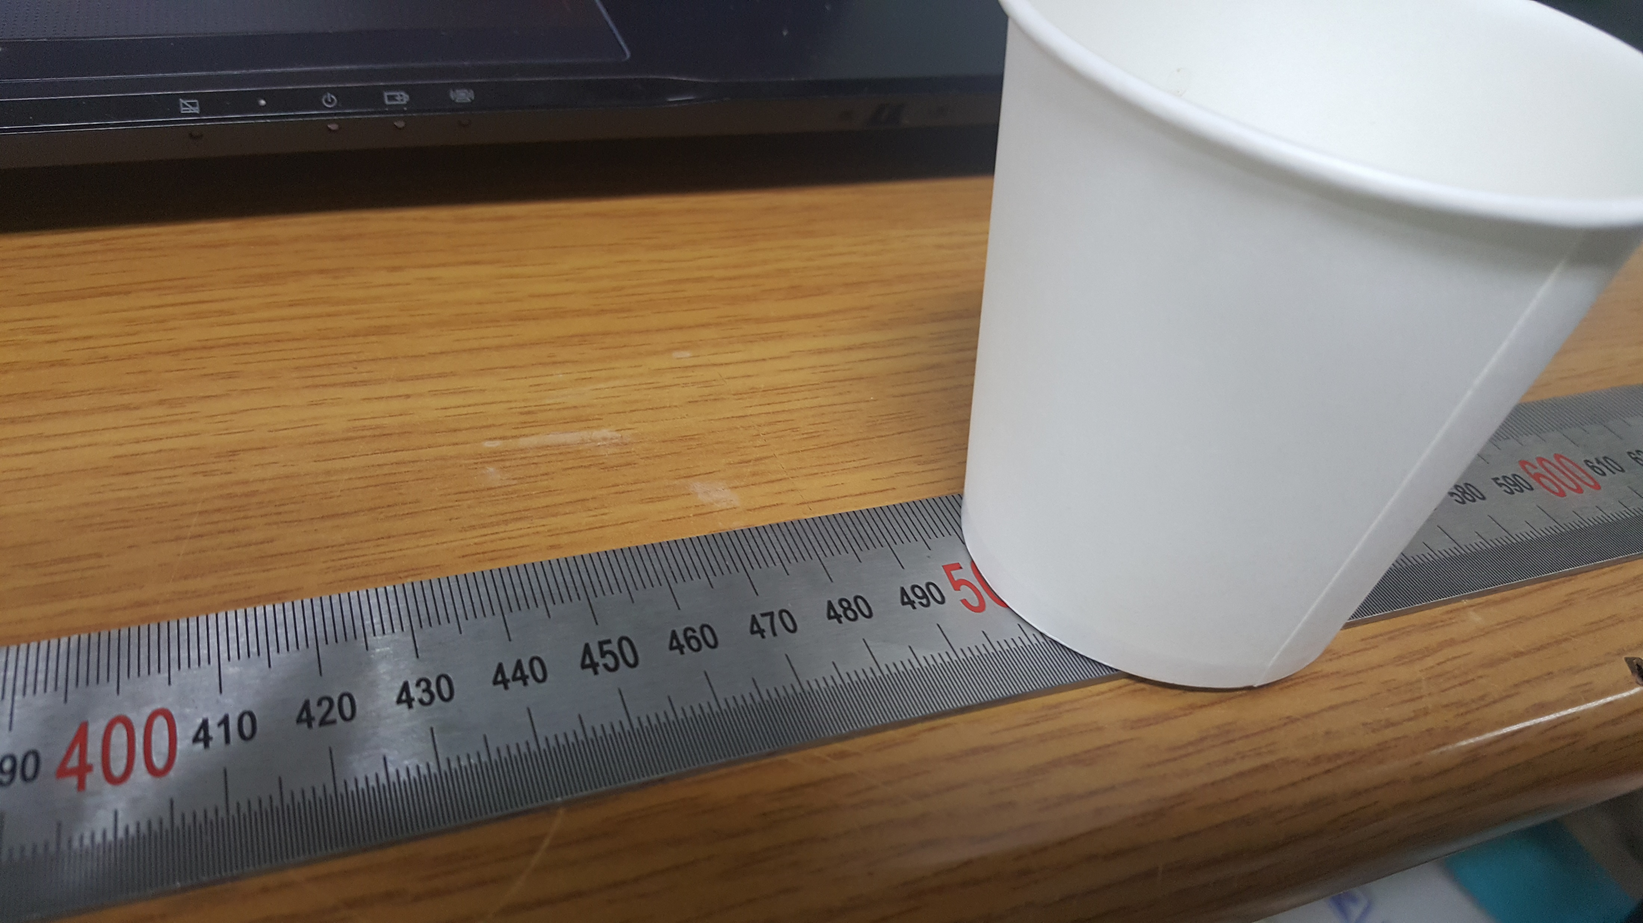
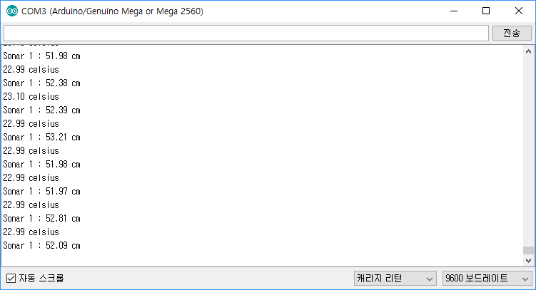
개발 현황 – 17/11/10
보다 정확한 거리 측정을 위해 온도센서로 기온을 측정하여 음속을 계산, 초음파 센서로 거리를 측정해 봄.
종이컵과, 휴대폰 액정을 대상으로 10회가량 측정을 해본 결과 ±3cm가량의 오차를 가짐.
종이컵을 대상으로 측정 시, 첫 회에선 정상적으로 측정되었으나, 다음 시도부터는 종이컵을 인식하지 못하는 현상을 보임. 측정 시도가 계속될수록 초음파의 반사율이 낮아지는듯 함.

Slide 12
개발 현황 – 17/11/13
A안 실험
측정 물체 : 팬텀3어드밴스드
초음파 센서 간 간격 : 13.3cm
초음파 센서와 지면 간 각도 : 15º
초음파 센서 간 측정 딜레이 : 300ms
각 위치에서 10회의 측정 시도

Slide 13
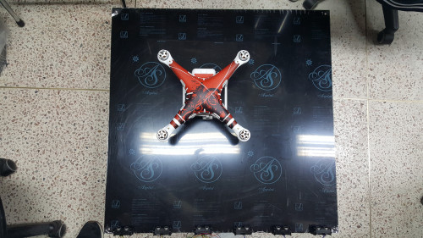
개발 현황 – 17/11/13
A안 1차 위치 측정 (35 x 45 [cm])
loop_count = 10
18.91 celsius
Sonar 1 duration : 5305
Distance : 90.94 cm
Sonar 2 duration : 5636
Distance : 96.61 cm
Sonar 3 duration : 2260
Distance : 38.74 cm
Sonar 4 duration : 2446
Distance : 41.93 cm
Sonar 5 duration : 5067
Distance : 86.86 cm
Sonar 6 duration : 4964
Distance : 85.09 cm
18.91 celsius
Sonar 1 duration : 5329
Distance : 91.35 cm
Sonar 2 duration : 5660
Distance : 97.02 cm
Sonar 3 duration : 2260
Distance : 38.74 cm
Sonar 4 duration : 2446
Distance : 41.93 cm
Sonar 5 duration : 5090
Distance : 87.25 cm
Sonar 6 duration : 4963
Distance : 85.08 cm
18.91 celsius
Sonar 1 duration : 5309
Distance : 91.01 cm
Sonar 2 duration : 5711
Distance : 97.90 cm
Sonar 3 duration : 2260
Distance : 38.74 cm
Sonar 4 duration : 2422
Distance : 41.52 cm
Sonar 5 duration : 5090
Distance : 87.25 cm
Sonar 6 duration : 4890
Distance : 83.83 cm
19.01 celsius
Sonar 1 duration : 5336
Distance : 91.49 cm
Sonar 2 duration : 5717
Distance : 98.02 cm
Sonar 3 duration : 2260
Distance : 38.75 cm
Sonar 4 duration : 2422
Distance : 41.53 cm
Sonar 5 duration : 5043
Distance : 86.46 cm
Sonar 6 duration : 4964
Distance : 85.11 cm
18.91 celsius
Sonar 1 duration : 5336
Distance : 91.47 cm
Sonar 2 duration : 5692
Distance : 97.57 cm
Sonar 3 duration : 2287
Distance : 39.20 cm
Sonar 4 duration : 2416
Distance : 41.42 cm
Sonar 5 duration : 5164
Distance : 88.52 cm
Sonar 6 duration : 4939
Distance : 84.67 cm
19.01 celsius
Sonar 1 duration : 5336
Distance : 91.49 cm
Sonar 2 duration : 5693
Distance : 97.61 cm
Sonar 3 duration : 2287
Distance : 39.21 cm
Sonar 4 duration : 2421
Distance : 41.51 cm
Sonar 5 duration : 5090
Distance : 87.27 cm
Sonar 6 duration : 5038
Distance : 86.38 cm
19.01 celsius
Sonar 1 duration : 5336
Distance : 91.49 cm
Sonar 2 duration : 5717
Distance : 98.02 cm
Sonar 3 duration : 2287
Distance : 39.21 cm
Sonar 4 duration : 2422
Distance : 41.53 cm
Sonar 5 duration : 5188
Distance : 88.95 cm
Sonar 6 duration : 4940
Distance : 84.70 cm
18.91 celsius
Sonar 1 duration : 5336
Distance : 91.47 cm
Sonar 2 duration : 5693
Distance : 97.59 cm
Sonar 3 duration : 2287
Distance : 39.20 cm
Sonar 4 duration : 2422
Distance : 41.52 cm
Sonar 5 duration : 5141
Distance : 88.13 cm
Sonar 6 duration : 4940
Distance : 84.68 cm
19.01 celsius
Sonar 1 duration : 5312
Distance : 91.08 cm
Sonar 2 duration : 5668
Distance : 97.18 cm
Sonar 3 duration : 2287
Distance : 39.21 cm
Sonar 4 duration : 2421
Distance : 41.51 cm
Sonar 5 duration : 5067
Distance : 86.88 cm
Sonar 6 duration : 4939
Distance : 84.68 cm
19.01 celsius
Sonar 1 duration : 5336
Distance : 91.49 cm
Sonar 2 duration : 5692
Distance : 97.59 cm
Sonar 3 duration : 2287
Distance : 39.21 cm
Sonar 4 duration : 2416
Distance : 41.42 cm
Sonar 5 duration : 5044
Distance : 86.48 cm
Sonar 6 duration : 4940
Distance : 84.70 cm

Slide 14
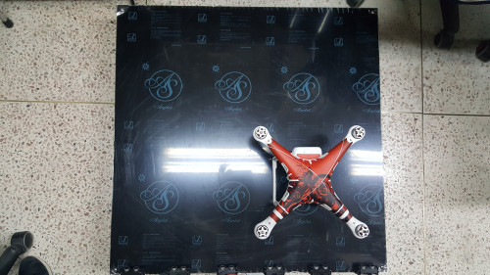
개발 현황 – 17/11/13
A안 2차 위치 측정 (55 x 25 [cm])
loop_count = 10
18.91 celsius
Sonar 1 duration : 5375
Distance : 92.14 cm
Sonar 2 duration : 5717
Distance : 98.00 cm
Sonar 3 duration : 5792
Distance : 99.29 cm
Sonar 4 duration : 1439
Distance : 24.67 cm
Sonar 5 duration : 1191
Distance : 20.42 cm
Sonar 6 duration : 5127
Distance : 87.89 cm
19.01 celsius
Sonar 1 duration : 5361
Distance : 91.92 cm
Sonar 2 duration : 5717
Distance : 98.02 cm
Sonar 3 duration : 5798
Distance : 99.41 cm
Sonar 4 duration : 1445
Distance : 24.78 cm
Sonar 5 duration : 1191
Distance : 20.42 cm
Sonar 6 duration : 5104
Distance : 87.51 cm
19.01 celsius
Sonar 1 duration : 5384
Distance : 92.31 cm
Sonar 2 duration : 5717
Distance : 98.02 cm
Sonar 3 duration : 5676
Distance : 97.32 cm
Sonar 4 duration : 1445
Distance : 24.78 cm
Sonar 5 duration : 1185
Distance : 20.32 cm
Sonar 6 duration : 5104
Distance : 87.51 cm
18.91 celsius
Sonar 1 duration : 5378
Distance : 92.19 cm
Sonar 2 duration : 5711
Distance : 97.90 cm
Sonar 3 duration : 5671
Distance : 97.21 cm
Sonar 4 duration : 1439
Distance : 24.67 cm
Sonar 5 duration : 1192
Distance : 20.43 cm
Sonar 6 duration : 5127
Distance : 87.89 cm
19.01 celsius
Sonar 1 duration : 5354
Distance : 91.80 cm
Sonar 2 duration : 5711
Distance : 97.92 cm
Sonar 3 duration : 5768
Distance : 98.89 cm
Sonar 4 duration : 1439
Distance : 24.67 cm
Sonar 5 duration : 1191
Distance : 20.42 cm
Sonar 6 duration : 5128
Distance : 87.92 cm
18.91 celsius
Sonar 1 duration : 5360
Distance : 91.88 cm
Sonar 2 duration : 5717
Distance : 98.00 cm
Sonar 3 duration : 5652
Distance : 96.89 cm
Sonar 4 duration : 1446
Distance : 24.79 cm
Sonar 5 duration : 1191
Distance : 20.42 cm
Sonar 6 duration : 5080
Distance : 87.08 cm
19.01 celsius
Sonar 1 duration : 5337
Distance : 91.51 cm
Sonar 2 duration : 5711
Distance : 97.92 cm
Sonar 3 duration : 5622
Distance : 96.39 cm
Sonar 4 duration : 1439
Distance : 24.67 cm
Sonar 5 duration : 1192
Distance : 20.44 cm
Sonar 6 duration : 5080
Distance : 87.10 cm
19.01 celsius
Sonar 1 duration : 5354
Distance : 91.80 cm
Sonar 2 duration : 5687
Distance : 97.51 cm
Sonar 3 duration : 5598
Distance : 95.98 cm
Sonar 4 duration : 1446
Distance : 24.79 cm
Sonar 5 duration : 1191
Distance : 20.42 cm
Sonar 6 duration : 5080
Distance : 87.10 cm
18.91 celsius
Sonar 1 duration : 5336
Distance : 91.47 cm
Sonar 2 duration : 5717
Distance : 98.00 cm
Sonar 3 duration : 5628
Distance : 96.48 cm
Sonar 4 duration : 1445
Distance : 24.77 cm
Sonar 5 duration : 1185
Distance : 20.31 cm
Sonar 6 duration : 5056
Distance : 86.67 cm
18.91 celsius
Sonar 1 duration : 5330
Distance : 91.37 cm
Sonar 2 duration : 5662
Distance : 97.06 cm
Sonar 3 duration : 5622
Distance : 96.37 cm
Sonar 4 duration : 1446
Distance : 24.79 cm
Sonar 5 duration : 1191
Distance : 20.42 cm
Sonar 6 duration : 5103
Distance : 87.48 cm

Slide 15
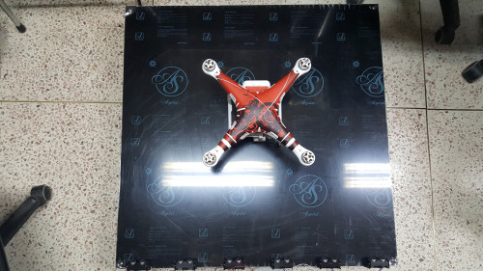
개발 현황 – 17/11/13
A안 3차 위치 측정 (40 x 40 [cm])
loop_count = 10
18.91 celsius
Sonar 1 duration : 5369
Distance : 92.04 cm
Sonar 2 duration : 5710
Distance : 97.88 cm
Sonar 3 duration : 2289
Distance : 39.24 cm
Sonar 4 duration : 2274
Distance : 38.98 cm
Sonar 5 duration : 5206
Distance : 89.24 cm
Sonar 6 duration : 5128
Distance : 87.91 cm
19.01 celsius
Sonar 1 duration : 5353
Distance : 91.78 cm
Sonar 2 duration : 5710
Distance : 97.90 cm
Sonar 3 duration : 2289
Distance : 39.25 cm
Sonar 4 duration : 2274
Distance : 38.99 cm
Sonar 5 duration : 5212
Distance : 89.36 cm
Sonar 6 duration : 5178
Distance : 88.78 cm
19.01 celsius
Sonar 1 duration : 5310
Distance : 91.04 cm
Sonar 2 duration : 5711
Distance : 97.92 cm
Sonar 3 duration : 2283
Distance : 39.14 cm
Sonar 4 duration : 2274
Distance : 38.99 cm
Sonar 5 duration : 5236
Distance : 89.77 cm
Sonar 6 duration : 5104
Distance : 87.51 cm
19.12 celsius
Sonar 1 duration : 5360
Distance : 91.92 cm
Sonar 2 duration : 5735
Distance : 98.35 cm
Sonar 3 duration : 2283
Distance : 39.15 cm
Sonar 4 duration : 2298
Distance : 39.41 cm
Sonar 5 duration : 5236
Distance : 89.79 cm
Sonar 6 duration : 5105
Distance : 87.54 cm
18.91 celsius
Sonar 1 duration : 5336
Distance : 91.47 cm
Sonar 2 duration : 5717
Distance : 98.00 cm
Sonar 3 duration : 2290
Distance : 39.26 cm
Sonar 4 duration : 2268
Distance : 38.88 cm
Sonar 5 duration : 5237
Distance : 89.77 cm
Sonar 6 duration : 5128
Distance : 87.91 cm
19.01 celsius
Sonar 1 duration : 5336
Distance : 91.49 cm
Sonar 2 duration : 5717
Distance : 98.02 cm
Sonar 3 duration : 2289
Distance : 39.25 cm
Sonar 4 duration : 2268
Distance : 38.89 cm
Sonar 5 duration : 5260
Distance : 90.18 cm
Sonar 6 duration : 5081
Distance : 87.12 cm
19.01 celsius
Sonar 1 duration : 5360
Distance : 91.90 cm
Sonar 2 duration : 5717
Distance : 98.02 cm
Sonar 3 duration : 2289
Distance : 39.25 cm
Sonar 4 duration : 2274
Distance : 38.99 cm
Sonar 5 duration : 5260
Distance : 90.18 cm
Sonar 6 duration : 4909
Distance : 84.17 cm
19.01 celsius
Sonar 1 duration : 5336
Distance : 91.49 cm
Sonar 2 duration : 5693
Distance : 97.61 cm
Sonar 3 duration : 2290
Distance : 39.26 cm
Sonar 4 duration : 2274
Distance : 38.99 cm
Sonar 5 duration : 5209
Distance : 89.31 cm
Sonar 6 duration : 5006
Distance : 85.83 cm
19.01 celsius
Sonar 1 duration : 5336
Distance : 91.49 cm
Sonar 2 duration : 5768
Distance : 98.89 cm
Sonar 3 duration : 2290
Distance : 39.26 cm
Sonar 4 duration : 2274
Distance : 38.99 cm
Sonar 5 duration : 5209
Distance : 89.31 cm
Sonar 6 duration : 5030
Distance : 86.24 cm
19.01 celsius
Sonar 1 duration : 5384
Distance : 92.31 cm
Sonar 2 duration : 5693
Distance : 97.61 cm
Sonar 3 duration : 2266
Distance : 38.85 cm
Sonar 4 duration : 2274
Distance : 38.99 cm
Sonar 5 duration : 5185
Distance : 88.90 cm
Sonar 6 duration : 5054
Distance : 86.65 cm

Slide 16
개발 현황 – 17/11/15
B안 실험
측정 물체 : SYMA X5HW(팬텀3은 다른 스케쥴로 인해 불가)
초음파 센서 간 간격 : 26.7cm
초음파 센서와 지면 간 각도 : 15º
초음파 센서 간 측정 딜레이 : 300ms
각 위치에서 10회의 측정 시도

Slide 17
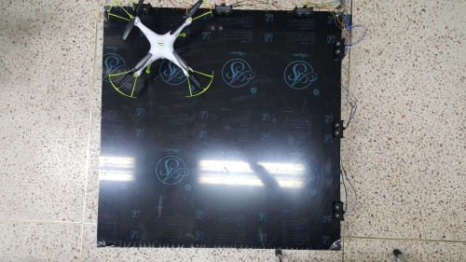
개발 현황 – 17/11/15
B안 1차 위치 측정 (26 x 54 [cm])
loop_count = 10
19.23 celsius
Sonar 1 duration : 5618
Distance : 96.36 cm
Sonar 2 duration : 6008
Distance : 103.05 cm
Sonar 3 duration : 5854
Distance : 100.41 cm
Sonar 4 duration : 5262
Distance : 90.25 cm
Sonar 5 duration : 7362
Distance : 126.27 cm
Sonar 6 duration : 9747
Distance : 167.18 cm
19.23 celsius
Sonar 1 duration : 2751
Distance : 47.18 cm
Sonar 2 duration : 5934
Distance : 101.78 cm
Sonar 3 duration : 5831
Distance : 100.01 cm
Sonar 4 duration : 5286
Distance : 90.66 cm
Sonar 5 duration : 7436
Distance : 127.54 cm
Sonar 6 duration : 9796
Distance : 168.02 cm
19.23 celsius
Sonar 1 duration : 5643
Distance : 96.79 cm
Sonar 2 duration : 5957
Distance : 102.17 cm
Sonar 3 duration : 5977
Distance : 102.52 cm
Sonar 4 duration : 5286
Distance : 90.66 cm
Sonar 5 duration : 7436
Distance : 127.54 cm
Sonar 6 duration : 9796
Distance : 168.02 cm
19.34 celsius
Sonar 1 duration : 5643
Distance : 96.81 cm
Sonar 2 duration : 5933
Distance : 101.78 cm
Sonar 3 duration : 5831
Distance : 100.03 cm
Sonar 4 duration : 5261
Distance : 90.25 cm
Sonar 5 duration : 7463
Distance : 128.03 cm
Sonar 6 duration : 9895
Distance : 169.75 cm
19.34 celsius
Sonar 1 duration : 5643
Distance : 96.81 cm
Sonar 2 duration : 5933
Distance : 101.78 cm
Sonar 3 duration : 5834
Distance : 100.08 cm
Sonar 4 duration : 5213
Distance : 89.43 cm
Sonar 5 duration : 8289
Distance : 142.20 cm
Sonar 6 duration : 9894
Distance : 169.73 cm
19.34 celsius
Sonar 1 duration : 5618
Distance : 96.38 cm
Sonar 2 duration : 5957
Distance : 102.19 cm
Sonar 3 duration : 5976
Distance : 102.52 cm
Sonar 4 duration : 5213
Distance : 89.43 cm
Sonar 5 duration : 7487
Distance : 128.44 cm
Sonar 6 duration : 9769
Distance : 167.59 cm
19.23 celsius
Sonar 1 duration : 5619
Distance : 96.38 cm
Sonar 2 duration : 5981
Distance : 102.59 cm
Sonar 3 duration : 5952
Distance : 102.09 cm
Sonar 4 duration : 5288
Distance : 90.70 cm
Sonar 5 duration : 7487
Distance : 128.42 cm
Sonar 6 duration : 9846
Distance : 168.88 cm
19.23 celsius
Sonar 1 duration : 5592
Distance : 95.91 cm
Sonar 2 duration : 5982
Distance : 102.60 cm
Sonar 3 duration : 5884
Distance : 100.92 cm
Sonar 4 duration : 5361
Distance : 91.95 cm
Sonar 5 duration : 7412
Distance : 127.13 cm
Sonar 6 duration : 9773
Distance : 167.63 cm
19.34 celsius
Sonar 1 duration : 5619
Distance : 96.39 cm
Sonar 2 duration : 5957
Distance : 102.19 cm
Sonar 3 duration : 5837
Distance : 100.13 cm
Sonar 4 duration : 5237
Distance : 89.84 cm
Sonar 5 duration : 7388
Distance : 126.74 cm
Sonar 6 duration : 9848
Distance : 168.94 cm
19.34 celsius
Sonar 1 duration : 5595
Distance : 95.98 cm
Sonar 2 duration : 5957
Distance : 102.19 cm
Sonar 3 duration : 5807
Distance : 99.62 cm
Sonar 4 duration : 5237
Distance : 89.84 cm
Sonar 5 duration : 7487
Distance : 128.44 cm
Sonar 6 duration : 10877
Distance : 186.60 cm

Slide 18
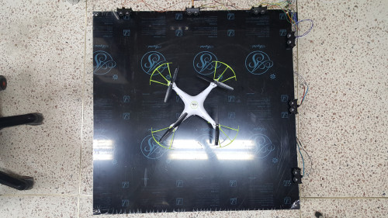
개발 현황 – 17/11/15
B안 2차 위치 측정 (40 x 40 [cm])
loop_count = 10
19.23 celsius
Sonar 1 duration : 6371
Distance : 109.27 cm
Sonar 2 duration : 2071
Distance : 35.52 cm
Sonar 3 duration : 5449
Distance : 93.46 cm
Sonar 4 duration : 6082
Distance : 104.32 cm
Sonar 5 duration : 2211
Distance : 37.92 cm
Sonar 6 duration : 7313
Distance : 125.43 cm
19.34 celsius
Sonar 1 duration : 6391
Distance : 109.64 cm
Sonar 2 duration : 2070
Distance : 35.51 cm
Sonar 3 duration : 5449
Distance : 93.48 cm
Sonar 4 duration : 6058
Distance : 103.93 cm
Sonar 5 duration : 2211
Distance : 37.93 cm
Sonar 6 duration : 7872
Distance : 135.04 cm
19.34 celsius
Sonar 1 duration : 6373
Distance : 109.33 cm
Sonar 2 duration : 2071
Distance : 35.53 cm
Sonar 3 duration : 5473
Distance : 93.89 cm
Sonar 4 duration : 7921
Distance : 135.89 cm
Sonar 5 duration : 2211
Distance : 37.93 cm
Sonar 6 duration : 7405
Distance : 127.03 cm
19.34 celsius
Sonar 1 duration : 6397
Distance : 109.74 cm
Sonar 2 duration : 2071
Distance : 35.53 cm
Sonar 3 duration : 5445
Distance : 93.41 cm
Sonar 4 duration : 6057
Distance : 103.91 cm
Sonar 5 duration : 2211
Distance : 37.93 cm
Sonar 6 duration : 6999
Distance : 120.07 cm
19.34 celsius
Sonar 1 duration : 6366
Distance : 109.21 cm
Sonar 2 duration : 2071
Distance : 35.53 cm
Sonar 3 duration : 5452
Distance : 93.53 cm
Sonar 4 duration : 6232
Distance : 106.91 cm
Sonar 5 duration : 2235
Distance : 38.34 cm
Sonar 6 duration : 7387
Distance : 126.72 cm
19.34 celsius
Sonar 1 duration : 6391
Distance : 109.64 cm
Sonar 2 duration : 2071
Distance : 35.53 cm
Sonar 3 duration : 5452
Distance : 93.53 cm
Sonar 4 duration : 7891
Distance : 135.37 cm
Sonar 5 duration : 2235
Distance : 38.34 cm
Sonar 6 duration : 7330
Distance : 125.75 cm
19.23 celsius
Sonar 1 duration : 6372
Distance : 109.29 cm
Sonar 2 duration : 2071
Distance : 35.52 cm
Sonar 3 duration : 5450
Distance : 93.48 cm
Sonar 4 duration : 6232
Distance : 106.89 cm
Sonar 5 duration : 2211
Distance : 37.92 cm
Sonar 6 duration : 7412
Distance : 127.13 cm
19.34 celsius
Sonar 1 duration : 6397
Distance : 109.74 cm
Sonar 2 duration : 2071
Distance : 35.53 cm
Sonar 3 duration : 5452
Distance : 93.53 cm
Sonar 4 duration : 6082
Distance : 104.34 cm
Sonar 5 duration : 2211
Distance : 37.93 cm
Sonar 6 duration : 7312
Distance : 125.44 cm
19.12 celsius
Sonar 1 duration : 6396
Distance : 109.68 cm
Sonar 2 duration : 2071
Distance : 35.51 cm
Sonar 3 duration : 5452
Distance : 93.49 cm
Sonar 4 duration : 7918
Distance : 135.78 cm
Sonar 5 duration : 2211
Distance : 37.92 cm
Sonar 6 duration : 6949
Distance : 119.17 cm
19.23 celsius
Sonar 1 duration : 6370
Distance : 109.26 cm
Sonar 2 duration : 2071
Distance : 35.52 cm
Sonar 3 duration : 5453
Distance : 93.53 cm
Sonar 4 duration : 8795
Distance : 150.85 cm
Sonar 5 duration : 2211
Distance : 37.92 cm
Sonar 6 duration : 7404
Distance : 126.99 cm

Slide 19
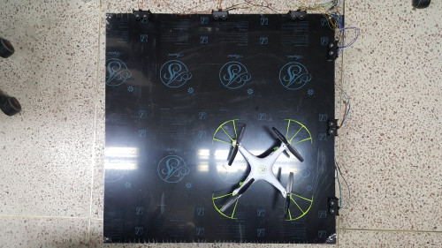
개발 현황 – 17/11/15
B안 3차 위치 측정 (60 x 15 [cm])
loop_count = 10
19.12 celsius
Sonar 1 duration : 5241
Distance : 89.88 cm
Sonar 2 duration : 6748
Distance : 115.72 cm
Sonar 3 duration : 6093
Distance : 104.49 cm
Sonar 4 duration : 6525
Distance : 111.89 cm
Sonar 5 duration : 8050
Distance : 138.05 cm
Sonar 6 duration : 8085
Distance : 138.65 cm
19.12 celsius
Sonar 1 duration : 5217
Distance : 89.46 cm
Sonar 2 duration : 6741
Distance : 115.60 cm
Sonar 3 duration : 6093
Distance : 104.49 cm
Sonar 4 duration : 6359
Distance : 109.05 cm
Sonar 5 duration : 8005
Distance : 137.27 cm
Sonar 6 duration : 8034
Distance : 137.77 cm
19.12 celsius
Sonar 1 duration : 5242
Distance : 89.89 cm
Sonar 2 duration : 6747
Distance : 115.70 cm
Sonar 3 duration : 6117
Distance : 104.90 cm
Sonar 4 duration : 6401
Distance : 109.77 cm
Sonar 5 duration : 7999
Distance : 137.17 cm
Sonar 6 duration : 8202
Distance : 140.65 cm
19.12 celsius
Sonar 1 duration : 5242
Distance : 89.89 cm
Sonar 2 duration : 6848
Distance : 117.43 cm
Sonar 3 duration : 6115
Distance : 104.86 cm
Sonar 4 duration : 6359
Distance : 109.05 cm
Sonar 5 duration : 8077
Distance : 138.51 cm
Sonar 6 duration : 7694
Distance : 131.94 cm
19.34 celsius
Sonar 1 duration : 5217
Distance : 89.50 cm
Sonar 2 duration : 6767
Distance : 116.09 cm
Sonar 3 duration : 6043
Distance : 103.67 cm
Sonar 4 duration : 6425
Distance : 110.22 cm
Sonar 5 duration : 7791
Distance : 133.66 cm
Sonar 6 duration : 7667
Distance : 131.53 cm
19.12 celsius
Sonar 1 duration : 5242
Distance : 89.89 cm
Sonar 2 duration : 6842
Distance : 117.33 cm
Sonar 3 duration : 6138
Distance : 105.26 cm
Sonar 4 duration : 6359
Distance : 109.05 cm
Sonar 5 duration : 8151
Distance : 139.78 cm
Sonar 6 duration : 8613
Distance : 147.70 cm
19.23 celsius
Sonar 1 duration : 5266
Distance : 90.32 cm
Sonar 2 duration : 6740
Distance : 115.60 cm
Sonar 3 duration : 6165
Distance : 105.74 cm
Sonar 4 duration : 6383
Distance : 109.48 cm
Sonar 5 duration : 8055
Distance : 138.16 cm
Sonar 6 duration : 8158
Distance : 139.92 cm
19.12 celsius
Sonar 1 duration : 5242
Distance : 89.89 cm
Sonar 2 duration : 6716
Distance : 115.17 cm
Sonar 3 duration : 6138
Distance : 105.26 cm
Sonar 4 duration : 6500
Distance : 111.47 cm
Sonar 5 duration : 8078
Distance : 138.53 cm
Sonar 6 duration : 8183
Distance : 140.33 cm
19.12 celsius
Sonar 1 duration : 5241
Distance : 89.88 cm
Sonar 2 duration : 6722
Distance : 115.27 cm
Sonar 3 duration : 6165
Distance : 105.72 cm
Sonar 4 duration : 6624
Distance : 113.59 cm
Sonar 5 duration : 8152
Distance : 139.80 cm
Sonar 6 duration : 8233
Distance : 141.18 cm
19.12 celsius
Sonar 1 duration : 5266
Distance : 90.30 cm
Sonar 2 duration : 6842
Distance : 117.33 cm
Sonar 3 duration : 6189
Distance : 106.13 cm
Sonar 4 duration : 6458
Distance : 110.75 cm
Sonar 5 duration : 8026
Distance : 137.63 cm
Sonar 6 duration : 7671
Distance : 131.55 cm

Slide 20
개발 현황 – 17/11/15
A안과 B안을 비교한 결과
A안의 초음파센서 배치 시 2차원 평면상의 물체 감지에 무리가 없음을 확인함.
B안의 경우에는 초음파센서 간 사각지대가 존재하여 물체를 정확히 감지 못하는 것이 확인됨.
A, B안 모두 반사면과 물체의 재질에 따라 감지에 어려움이 있음.

Slide 21
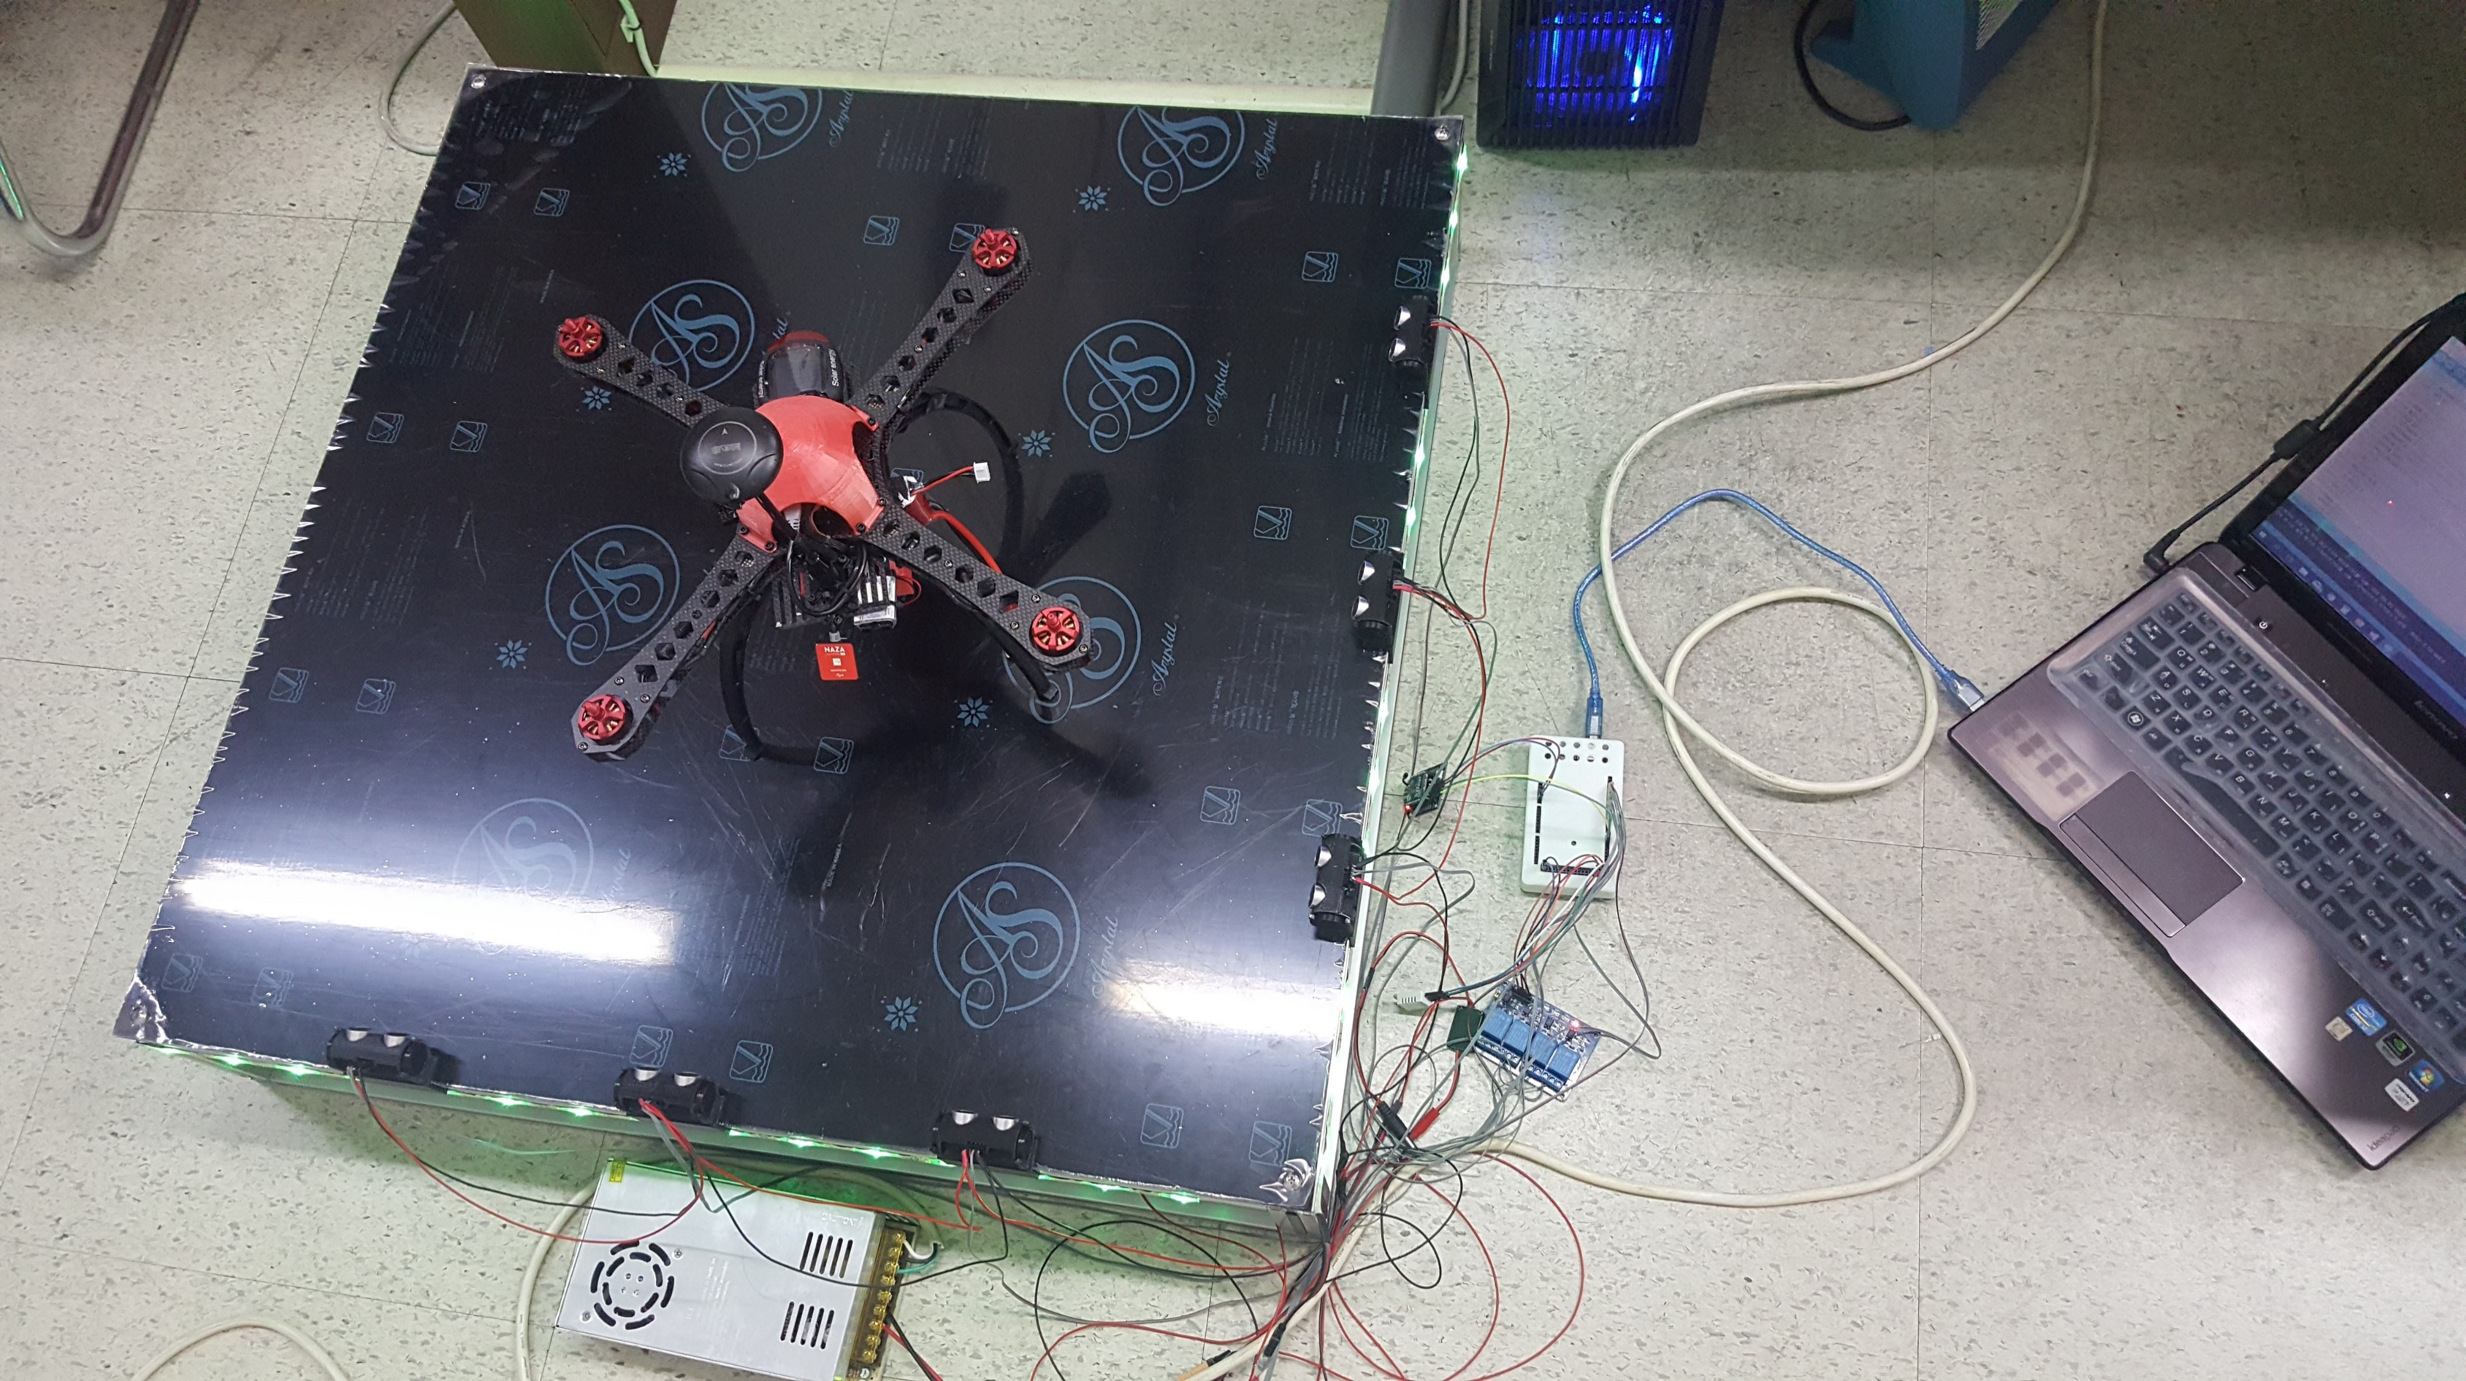
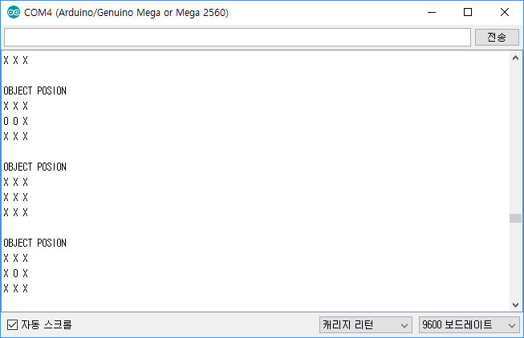
개발 현황 – 17/11/21
기존의 1.3버전에서 택트 스위치 대신 초음파 센서로 대체하고 최적화함.
전송하는 데이터 형식 변경(초음파 센서 거리값 -> 드론의 위치값) [데이터 포맷 참조]
A, B안을 절충하여 새롭게 C안을 기획하여 개발하였음.

Slide 22
개발 현황 – 17/11/21
C안
초음파 센서 X축 3개, Y축 3개 배열
거리 측정으로 위치를 파악
A, B안에서 발견된 반사면과 물체 재질에 의해 감지가 안되는 경우를 줄이기 위해 X축과 Y축 모두에서 거리감지를 통해 위치를 파악하게 함.
B안에서 발견한 사각지대의 문제점은 초음파 센서의 부족으로 인해 발생하므로, 센서 수량 추가로 해결가능 할 것으로 보임.

